Slide 1

Theoretical and Empirical Analysis of Audio Feature Representations for Speech Recognition
CS 5720 Neural Network & Deep Learning
Sajitha Konda , ByReddy Nishitha Reddy

Slide 2

Introduction to Speech Recognition
What is Speech Recognition?
Speech recognition enables machines to convert spoken language into text or commands. Feature extraction transforms raw audio signals into meaningful representations that capture phonetic characteristics.
Why Feature Extraction Matters
Effective features reduce dimensionality while preserving discriminative information, directly impacting recognition accuracy and system efficiency.

Slide 3




Project Objectives
Comparative Analysis
Performance Metrics
Robustness Testing
Evaluate MFCC, FBANK, and wav2vec 2.0 feature representations
Analyze classification accuracy across different feature sets
Test noise tolerance at varying signal-to-noise ratios

Slide 4

Dataset & Experimental Setup
Speech Commands Dataset
Four classes: yes, no, up, down
~15,000 one-second audio clips
16 kHz sampling rate
Preprocessed with trimming and padding
Classification Model
Support Vector Machine (SVM) with radial basis function (RBF) kernel for classification.

Slide 5





System Framework
Audio Input
Raw waveform files
Preprocessing
Trimming and padding
Feature Extraction
MFCC, FBANK, wav2vec
SVM Classifier
RBF kernel
Evaluation
Accuracy metrics

Slide 6

Feature Representations
MFCC (Mel-Frequency Cepstral Coefficients)
1
Compact, efficient representation mimicking human auditory perception. Extracts cepstral coefficients from mel-scale filter banks.
FBANK (Filter Bank Features)
2
Richer spectral detail through overlapping triangular filters. Preserves more raw spectral information than MFCC.
wav2vec 2.0 (Deep Learning-Based)
3
Self-supervised transformer architecture learning contextualized audio representations from unlabeled data.

Slide 7

Methodology
01
Audio Preprocessing
Trim silence, pad to uniform length
02
Feature Extraction
Generate MFCC, FBANK, and wav2vec embeddings
03
Model Training
SVM with RBF kernel, cross-validation
04
Evaluation
Accuracy calculation and noise robustness testing

Slide 8
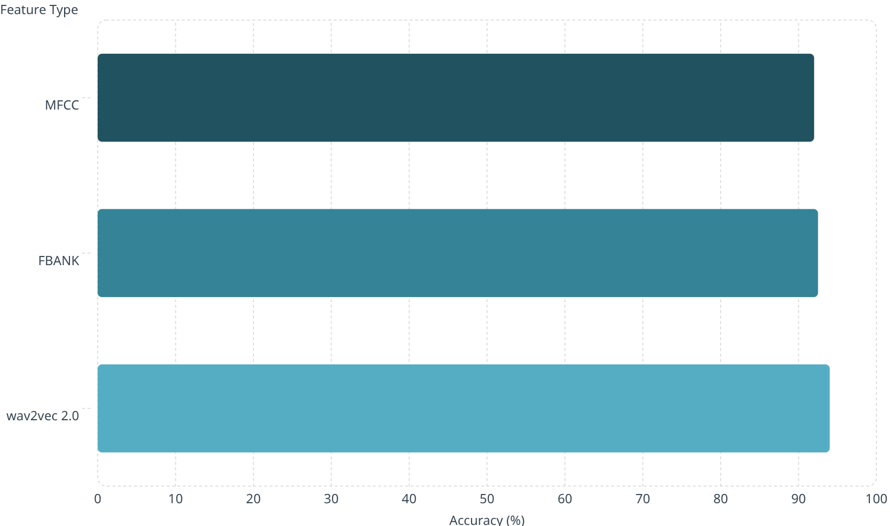
Accuracy Results
Performance Summary
wav2vec 2.0 achieves highest accuracy at 94.0%, followed by FBANK at 92.5% and MFCC at 92.0%.

Slide 9
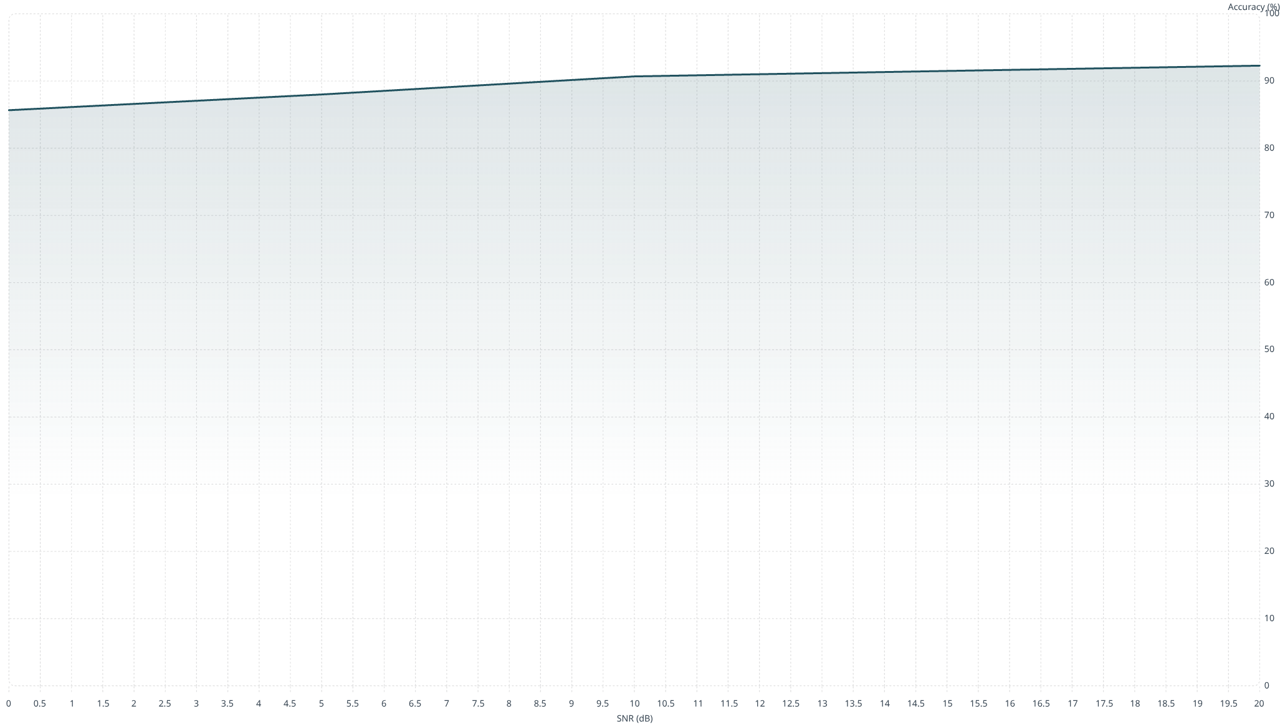
Noise Robustness Analysis
Signal-to-Noise Ratio (SNR) Impact on Accuracy
Gradual performance degradation observed as SNR decreases. wav2vec 2.0 maintains highest accuracy across all noise levels.

Slide 10



Key Findings & Future Work
Best Performance
Efficient Baseline
Robust Design
wav2vec 2.0 achieves 94% accuracy
MFCC provides 92% accuracy with lower computation
Gradual degradation maintains usability in noisy environments
Future Research Directions
Expand to additional command classes
Test with real-world environmental noise
Explore deep learning classifiers

